Slide 1

https://www.youtube.com/watch?v=B7r7YY_EO0A

Slide 2
Motivation
the reason or reasons one has for acting or behaving in a particular way
the general desire or willingness of someone to do something

Slide 3
Why is goal setting important
Drives behavior
Helps you establish priority
Achieve focus
Helps advance your agenda

Slide 4
SMART Goals
Specific Who, What, Where, When, Why
Measurable What is the finish line, when is it complete? (true or false, yes or no, or a number)
Achievable Is your finish line attainable within your timeline?
Realistic Does it fit into the overall reason you are doing this
Time-Bound By when? Set a timeline

Slide 5
SMART Goal / Objective Example
Goal: Increase revenue from my personal chef business.
SMART Goal: Increase revenue by 25% each month by catering 2 parties a month.
https://www.brighthubpm.com/methods-strategies/79127-explaining-the-concept-of-smart-goals-with-examples/
Notes:
Activity: how to make this into a SMART goal – how to create 3 SMART objectives for the SMART goal. Things to think about: marketing, hiring, planning, etc.

Slide 6
Example 2: Setting a SMART Goal
I want to be rich
How do I achieve this?
What is rich?
By when?

Slide 7
Goal Setting Worksheet Assignment
Where are you now?
Ultimate Goal (End Point) – Where do you want to be? (beginning of your co-op work term)
How will you get there?
Today Co-op Work Term

Slide 8
Creating the Path to Your Co-op
Self Assessment
what do you have to offer
Career Awareness – Research
what would qualify
Decision Making
What do you want from your work term?
Marketing Yourself
How do you get there?
Work
Successful work term

Slide 9
Self Assessment – know your product
Is the process of gathering information about yourself in order to make informed career decisions, to understand who you are and what your strengths and weakness are
A self assessment should include a look at your values, interests, personality and skills
It is important that you can leverage your skills, experience and abilities
When you better understand yourself you can better sell yourself to potential employers

Slide 10

Analyzing Your Skills
Identifying your ability or lack of ability to do something well, with expertise
http://predictivepeopleanalytics.com/selling-skills-assessment-tool/

Slide 11
Employability Skills Assessment
These are the skills you will need to enter, stay in, and progress in the world of work - whether you work on your own or as a part of a team. These skills can also be applied and used beyond the workplace in a range of daily activities.
(https://www.jobsetc.gc.ca/toolbox/checklists/employability.jsp?lang=e)
*Google – employability skills assessment
Fundamental Skills
Communicate, Manage Information, Use Numbers, Think and Solve Problems
Personal Management
Demonstrate Positive Attitudes and Behaviours, Be Responsible, Be Adaptable, Learn Continuously, Work Safely
Team Work Skills
Work With Others, Participate on Projects and Tasks

Slide 12

Understanding Your Values
Your values are the things that you believe are important in the way you live and work
Your values (should) determine your priorities, and, deep down, they're probably the measures you use to tell if your life is turning out the way you want it to.
Identifying your values will help you determine what is important in a career
Values exist, whether you recognize them or not. Life can be much easier when you acknowledge your values – and when you make plans and decisions that honour them
If you value family, but you have to work 70-hour weeks in your job, will you feel internal stress and conflict?
When you define your personal values, you discover what's truly important to you
http://blog.flourishstudios.co.uk/will-branding-really-make-a-difference-to-your-business-success/its-not-to-make-a-decision-once-you-know-your-values/

Slide 13
Personal Core Values:
Personal core values are beliefs or convictions that you embrace as standards of behaviour that you are unwilling to compromise.
They will guide your attitude, decision-making and behaviour.
An example of a personal core value might be:
“I value excellence above expediency and therefore will always do things to the best of my ability even when it is difficult to do so.”
Other personal values are honesty, integrity, professionalism, teamwork, service and good health.

Slide 14
Assessing Your Interests
Holland Codes
The Holland Occupational Themes is a theory of personality that focuses on career and vocational choice.
It groups people on the basis of their suitability for six different categories of occupations. The six types yield the RIASEC acronym, by which the theory is also commonly known.
The theory was developed by John L. Holland over the course of his career, starting in the 1950s. TAKE THE TEST The test consists of example tasks that you will have to rate by how much you would enjoy performing each on a scale of (1) dislike (2) slightly dislike (3) neither like not dislike (4) slightly enjoy (5) enjoy. The test will take most five to ten minutes to complete.
http://www.truity.com/test/holland-code-career-test (google Truity Holland Code)

Slide 15
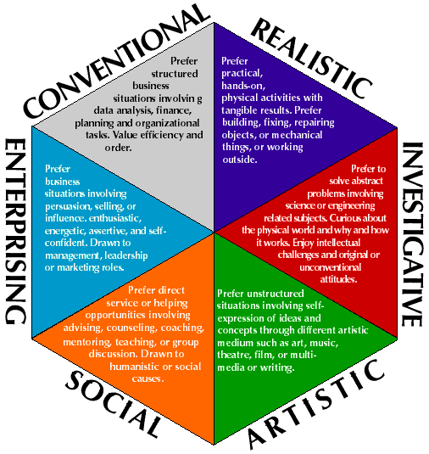
http://ged578.pbworks.com/w/page/25547863/Appropriate%20technologies%20for%20vocational%20students

Slide 16
Discovering your E.D.G.E.
Discovering your E.D.G.E. will provide you with the basis for getting on the right career track.
This plan will help you examine future career possibilities.
Notes:
Education, Direction, Gifts and Energy

Slide 17
Discovering Your Competitive E.D.G.E.
Your competitive edge consists of the following four components:
Education
Direction
Gifts
Energy
Notes:
17
In this career planner you will develop an awareness of how these four aspects of your competitive edge will provide you the basis for getting on the right educational track. Discovering your competitive edge begins with an an openness to look honestly at yourself, to identify information you currently know about yourself, about post-secondary education, about courses and about careers. This career planner will assist you in learning information which will be useful to you in your decision-making, it will assist you in exploring areas which may be unfamiliar and in developing an awareness of your own unique assets, aspirations, and abilities. It will involve you in a process of analysis, information gathering and decision-making. The exercises provided here are designed to help you reflect about yourself, your dreams, and your direction in life.
At the end of this career planner you will design a plan for developing your Competitive EDGE. This plan will help you figure out future possibilities, find your gifts, and focus your thinking so that you can select the courses that fit you.

Slide 18
Education and Knowledge
Assess current knowledge base
What current education/knowledge do I have?
Knowledge about potential careers?
Knowledge about self?
What do I need to do to fill the gap ?
Notes:
18
Education is a process of learning about yourself and your future. It is a process of figuring out how you can utilize your education at university most effectively. Education also involves learning more about post-secondary education itself, the courses that are offered, the expectations, the responsibilities and the opportunities. As you begin this session take some time to assess your current knowledge base. Use the following self-rating scale to quickly evaluate your current level of awareness. (A rating of 0 means you have no knowledge of that area, a rating of 5 means you have an average awareness about the area, and a rating of 10 means you are an expert in the area and could use your knowledge to advise others.)
Education is a process of learning about yourself and your future. It is a process of figuring out how you can utilize your education at university most effectively. Education also involves learning more about post-secondary education itself, the courses that are offered, the expectations, the responsibilities and the opportunities. As you begin this session take some time to assess your current knowledge base. Use the following self-rating scale to quickly evaluate your current level of awareness. (A rating of 0 means you have no knowledge of that area, a rating of 5 means you have an average awareness about the area, and a rating of 10 means you are an expert in the area and could use your knowledge to advise others.)

Slide 19
Direction
Where do I want to go?
Set goals and establish a plan
Make yourself accountable to keep your direction moving towards your goals
Notes:
19
If you don't know where you are going, how do you know if you have gotten there? One of the initial challenges of choosing a track which fits you is discovering the direction you wish to go. The direction you choose evolves from what you have done, where you are now, and some ideas of possibilities and alternatives you would like to consider. The following two part exercise will help you creatively discover the second component of your competitive edge, your personal direction.

Slide 20
Gifts
What do I have to offer?
Self-knowledge, self-awareness, self-confidence
Skills, Values, Interests (refer to self assessment tools)
Communicate these gifts through your marketing materials
Cover Letter and Resume
Online Profile
Interview Skills
Notes:
20
GIFTS (Self-knowledge, self-awareness, self-confidence)
You have unique talents or traits that are related to your current success and your future aspirations.
Because these gifts are so much a part of you, you may take them for granted or not realize that you possess them.
They are however the third critical component of your competitive edge.

Slide 21
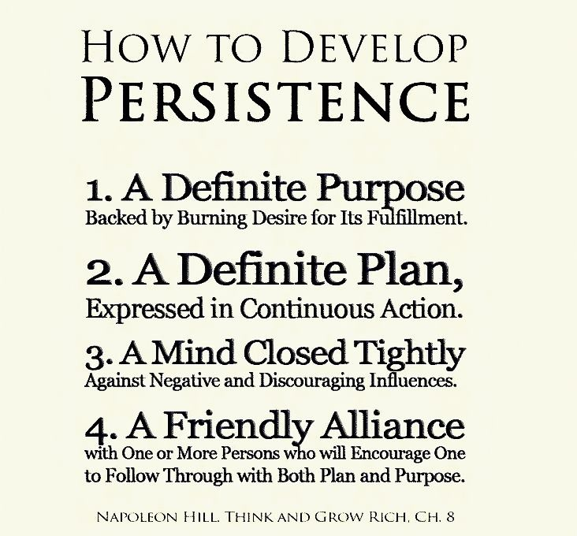
Energy
Enthusiasm and commitment to continue to work towards your goals
Determine what motivates you
https://www.facebook.com/photo.php?fbid=10151615018894131&set=pb.58576274130.-2207520000.1366917866.&type=3&theater
Notes:
21
The fourth critical component of your competitive edge is your energy. Your energy is that creative source within you that drives you and keeps you going. Each of us has learned how to refresh and motivate ourselves. Knowing how you motivate yourself and how you help yourself continue in spite of obstacles and barriers are all part of that special quality about you: your energy.

Slide 22
Co-op Work Term – Goal Setting Worksheet –
Worksheet consists of 4 SMART Goals & 3 SMART Objectives each
The SMART Objectives are the sub-goals/benchmarks/practical steps you need to take to meet the SMART Goals
Each SMART Goal and each SMART objective should be time-stamped!
Due Online: Wednesday, September 26, 2018 by 11:59 pm
Due In-class: Thursday, September 27, 2018 @ the start of class.
Feedback will be given – you will use the feedback for the large Co-op Work Term Action Plan assignment

Slide 23
Co-op Work Term Action Plan
End Point/Goal for Co-op Work Term
Goals & Objectives
Strategic Planning
Evaluation/Accountability
Refer to assignment outline and rubric for full details
Use the feedback provided from your Goal Setting Assignment
DUE WEEK 8

Slide 24
In-Class Activity: Holland Code
Complete the following assessment (link below)
Create an account to access results
Must show instructor results when completed
http://www.truity.com/test/holland-code-career-test (Google Truity Holland Code)

Slide 25
Week #3 - Online Work
EXPLORE Your Core Values – complete the values assessment test and identify your top 5 Core Values
http://www.whatsnext.com/content/life-values-self-assessment-test#Test
SUBMIT on Moodle– Values Assessment
Provide a definition of core values (site your source)
List your Top 5 Core Values from the values assessment you completed and provide an explanation for how accurate you feel the results of the test were to what you believe your core values are. You might not agree – which is fine!
REMEMBER: explanation should discuss co-op – how will these values relate to your field & co-op?
Watch: video https://www.youtube.com/watch?v=RgYmmjesuKw

